Slide 1
GAMES103: Intro to Physics-Based Animation
Linear Finite Element Method
Huamin Wang
Dec 2021

Slide 2
Topics for the Day
The linear finite element method (FEM)
The finite volume method (FVM)
Hyperelastic models

Slide 3
Linear Finite Element Method

Slide 4
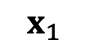
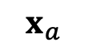
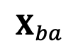
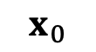
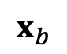
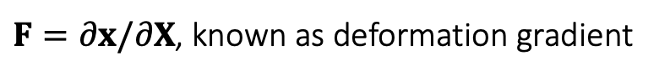
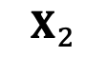
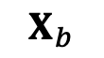
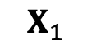
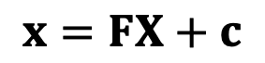
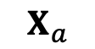
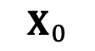
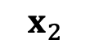
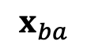
The Linear FEM Assumption
In a nutshell, linear FEM assumes that for any point $X$ in the reference triangle, its deformed correspondence is: $x=FX+c$.
$$X_{2}$$
constant translational vector
$$x_{2}$$
$$x=FX+c$$
$$x_{b}$$
$$X_{b}$$
$$X_{a}$$
constant matrix
$$x_{ba}$$
$$X_{ba}$$
$$x_{1}$$
$F=∂x/∂X$, known as deformation gradient
$$x_{a}$$
$$X_{0}$$
$$X_{1}$$
Reference (undeformed)
$$x_{0}$$
Current (deformed)
For any vector between two points, we can use $F$to convert it from reference to deformed:
$x_{ba}=x_{b}−x_{a}=FX_{b}+c−FX_{a}−c=FX_{ba}$.

Slide 5
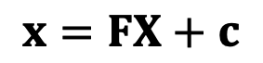
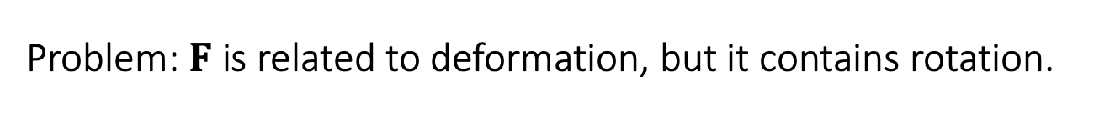
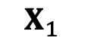
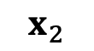
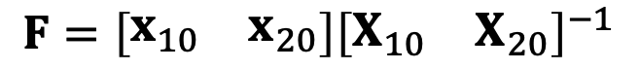
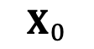
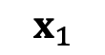
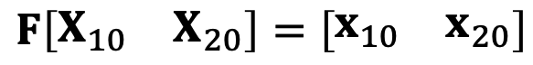
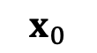
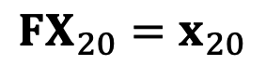
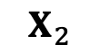
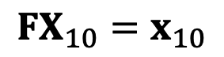
Deformation Gradient
Therefore, we can calculate the deformation gradient by edge vectors.
$$X_{2}$$
$$x_{2}$$
$$x=FX+c$$
$$FX_{10}=x_{10}$$
$$FX_{20}=x_{20}$$
$$x_{1}$$
$$X_{0}$$
$$X_{1}$$
$$F\left[\begin{matrix}X_{10} & X_{20}\end{matrix}\right]=\left[\begin{matrix}x_{10} & x_{20}\end{matrix}\right]$$
Reference (undeformed)
$$x_{0}$$
Current (deformed)
$$F=\left[\begin{matrix}x_{10} & x_{20}\end{matrix}\right]{\left[\begin{matrix}X_{10} & X_{20}\end{matrix}\right]}^{−1}$$
Problem: $F$ is related to deformation, but it contains rotation.

Slide 6
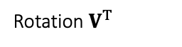
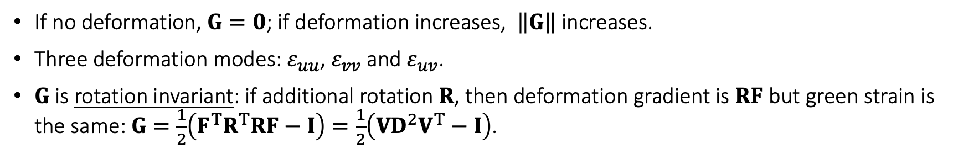
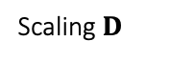

Green Strain
Ideally, we need a tensor to describe shape deformation only. Recall that SVD gives ${F=UDV}^{T}$, where only $V^{T}$ and $D$ are relevant to deformation.
Rotation $V^{T}$
Scaling $D$
Rotation $U$
So we get rid of $U$ as: $G=\frac{1}{2}\left(F^{T}F−I\right)=\frac{1}{2}\left(VD^{2}V^{T}−I\right)=\left[\begin{matrix}ε_{uu} & ε_{uv} \\ ε_{uv} & ε_{vv}\end{matrix}\right]$, Green strain.
If no deformation, $G=0$; if deformation increases, $\left\|G\right\|$ increases.
Three deformation modes: $ε_{uu}$, $ε_{vv}$ and $ε_{uv}$.
$G$ is rotation invariant: if additional rotation $R$, then deformation gradient is $RF$ but green strain is the same: $G=\frac{1}{2}\left(F^{T}R^{T}RF−I\right)=\frac{1}{2}\left(VD^{2}V^{T}−I\right)$.

Slide 7
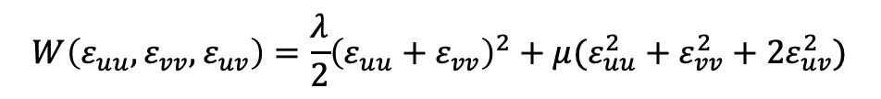
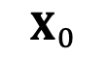
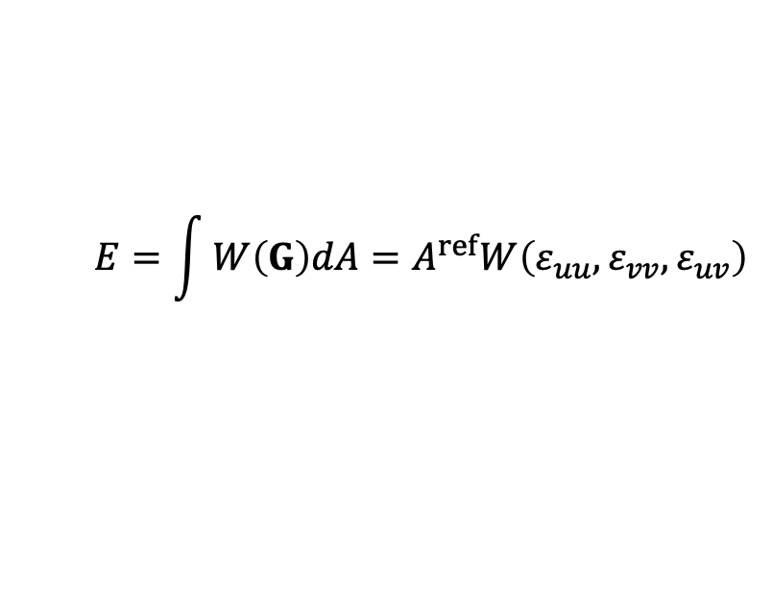
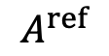
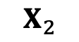
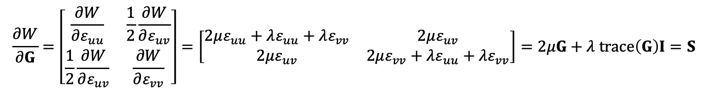
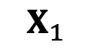
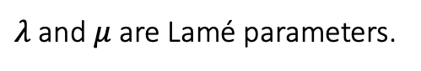
Strain Energy Density Function
Let $G$be the the green strain describing deformation. We consider the energy density per reference area as: $W(G)$.
Total energy:
Constant within the triangle
$$X_{2}$$
$$E=\int{W\left(G\right)dA}=A^{ref}W\left(ε_{uu},ε_{vv},ε_{uv}\right)$$
The Saint Venant-Kirchhoff Model (StVK)
$$A^{ref}$$
$$W\left(ε_{uu},ε_{vv},ε_{uv}\right)=\frac{λ}{2}{\left(ε_{uu}+ε_{vv}\right)}^{2}+μ(ε_{uu}^{2}+ε_{vv}^{2}+2ε_{uv}^{2})$$
$λ$ and $μ$ are Lamé parameters.
$$X_{0}$$
$$X_{1}$$
$$\frac{∂W}{∂G}=\left[\begin{matrix}\frac{∂W}{∂ε_{uu}} & \frac{1}{2}\frac{∂W}{∂ε_{uv}} \\ \frac{1}{2}\frac{∂W}{∂ε_{uv}} & \frac{∂W}{∂ε_{vv}}\end{matrix}\right]=\left[\begin{matrix}2με_{uu}+λε_{uu}+λε_{vv} & 2με_{uv} \\ 2με_{uv} & 2με_{vv}+λε_{uu}+λε_{vv}\end{matrix}\right]=2μG+λ trace\left(G\right)I=S$$
Second Piola-Kirchhoff tress tensor,
something about force

Slide 8
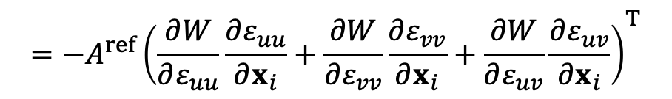
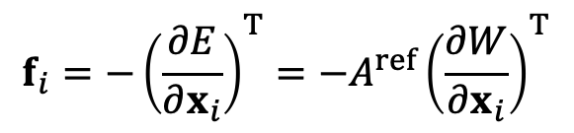
Forces
Given everything we have, we can now calculate the forces.
$$f_{i}=−{\left(\frac{∂E}{∂x_{i}}\right)}^{T}=−A^{ref}{\left(\frac{∂W}{∂x_{i}}\right)}^{T}$$
$$=−A^{ref}{\left(\frac{∂W}{∂ε_{uu}}\frac{∂ε_{uu}}{∂x_{i}}+\frac{∂W}{∂ε_{vv}}\frac{∂ε_{vv}}{∂x_{i}}+\frac{∂W}{∂ε_{uv}}\frac{∂ε_{uv}}{∂x_{i}}\right)}^{T}$$
As in stress

Slide 9
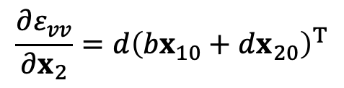
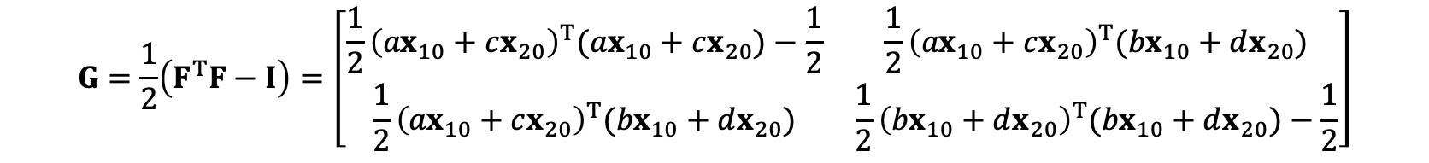
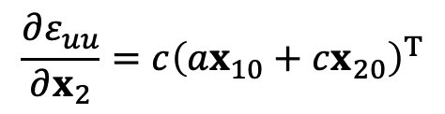
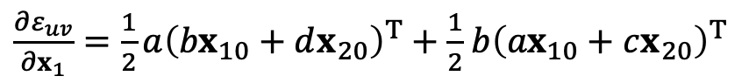
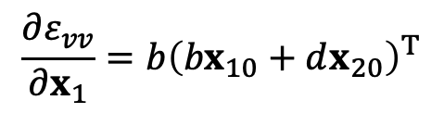
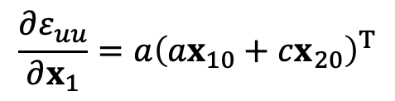
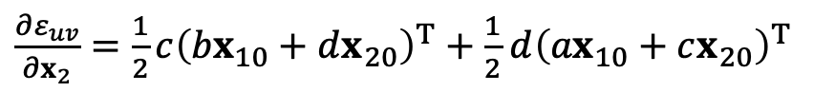
Forces
Recall that,
$F=\left[\begin{matrix}x_{10} & x_{20}\end{matrix}\right]{\left[\begin{matrix}X_{10} & X_{20}\end{matrix}\right]}^{−1}=\left[\begin{matrix}x_{10} & x_{20}\end{matrix}\right]$ $\left[\begin{matrix}a & b \\ c & d\end{matrix}\right]=\left[\begin{matrix}{ax}_{10}+cx_{20} & {bx}_{10}+dx_{20}\end{matrix}\right]$
By definition,
$$G=\frac{1}{2}\left(F^{T}F−I\right)=\left[\begin{matrix}\frac{1}{2}{\left({ax}_{10}+cx_{20}\right)}^{T}({ax}_{10}+cx_{20})−\frac{1}{2} & \frac{1}{2}{\left({ax}_{10}+cx_{20}\right)}^{T}({bx}_{10}+dx_{20}) \\ \frac{1}{2}{\left({ax}_{10}+cx_{20}\right)}^{T}({bx}_{10}+dx_{20}) & \frac{1}{2}{\left({bx}_{10}+dx_{20}\right)}^{T}({bx}_{10}+dx_{20})−\frac{1}{2}\end{matrix}\right]$$
So:
$$\frac{∂ε_{uu}}{∂x_{1}}=a{\left({ax}_{10}+cx_{20}\right)}^{T}$$
$$\frac{∂ε_{vv}}{∂x_{1}}=b{\left({bx}_{10}+dx_{20}\right)}^{T}$$
$\frac{∂ε_{uv}}{∂x_{1}}=\frac{1}{2}a{\left({bx}_{10}+dx_{20}\right)}^{T}+\frac{1}{2}$ $b{\left({ax}_{10}+cx_{20}\right)}^{T}$
$$\frac{∂ε_{uu}}{∂x_{2}}=c{\left({ax}_{10}+cx_{20}\right)}^{T}$$
$$\frac{∂ε_{vv}}{∂x_{2}}=d{\left({bx}_{10}+dx_{20}\right)}^{T}$$
$\frac{∂ε_{uv}}{∂x_{2}}=\frac{1}{2}c{\left({bx}_{10}+dx_{20}\right)}^{T}+\frac{1}{2}$ $d{\left({ax}_{10}+cx_{20}\right)}^{T}$

Slide 10
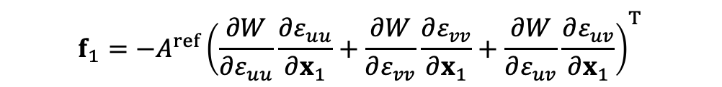
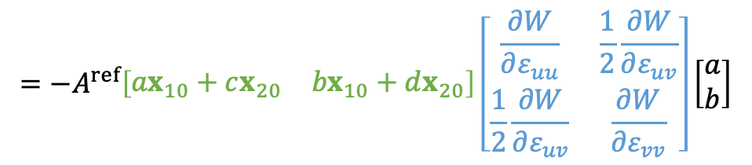
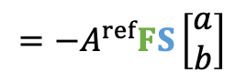

Forces
Together, we get:
$$f_{1}=−A^{ref}{\left(\frac{∂W}{∂ε_{uu}}\frac{∂ε_{uu}}{∂x_{1}}+\frac{∂W}{∂ε_{vv}}\frac{∂ε_{vv}}{∂x_{1}}+\frac{∂W}{∂ε_{uv}}\frac{∂ε_{uv}}{∂x_{1}}\right)}^{T}$$
$$=−A^{ref}\left(\frac{∂W}{∂ε_{uu}} a{\left({ax}_{10}+cx_{20}\right)}^{T}+\frac{∂W}{∂ε_{vv}}b{\left({bx}_{10}+dx_{20}\right)}^{T}+\frac{∂W}{∂ε_{uv}}\frac{1}{2}a{\left({bx}_{10}+dx_{20}\right)}^{T}+\frac{∂W}{∂ε_{uv}}\frac{1}{2} b{\left({ax}_{10}+cx_{20}\right)}^{T}\right)$$
$$=−A^{ref}\left(\left[\begin{matrix}{ax}_{10}+cx_{20} & {bx}_{10}+dx_{20}\end{matrix}\right]\left[\begin{matrix}\frac{∂W}{∂ε_{uu}} a+\frac{∂W}{∂ε_{uv}}\frac{1}{2} b \\ \frac{∂W}{∂ε_{uv}}\frac{1}{2}a+\frac{∂W}{∂ε_{vv}}b\end{matrix}\right]\right)$$
$$=−A^{ref}\left[\begin{matrix}{ax}_{10}+cx_{20} & {bx}_{10}+dx_{20}\end{matrix}\right]\left[\begin{matrix}\frac{∂W}{∂ε_{uu}} & \frac{1}{2}\frac{∂W}{∂ε_{uv}} \\ \frac{1}{2}\frac{∂W}{∂ε_{uv}} & \frac{∂W}{∂ε_{vv}}\end{matrix}\right]\left[\begin{matrix}a \\ b\end{matrix}\right]$$
$$=−A^{ref}FS\left[\begin{matrix}a \\ b\end{matrix}\right]$$
deformation gradient
Second Piola-Kirchhoff Stress

Slide 11

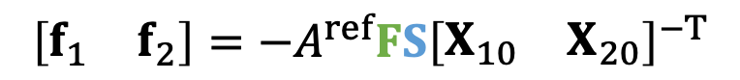

Forces
In conclusion, we have:
$$f_{1}=−A^{ref}FS\left[\begin{matrix}a \\ b\end{matrix}\right]$$
$$f_{2}=−A^{ref}FS\left[\begin{matrix}c \\ d\end{matrix}\right]$$
$$\left[\begin{matrix}f_{1} & f_{2}\end{matrix}\right]=−A^{ref}{FS\left[\begin{matrix}X_{10} & X_{20}\end{matrix}\right]}^{−T}$$

Slide 12

Implementations
More details?
Volino et al. 2009. A simple approach to nonlinear tensile stiffness for accurate cloth simulation. TOG
Only talks about cloth (2D reference -> 3D deformation)
What about tetrahedron (3D reference -> 3D deformation)?
Same idea, but everything is now in 3D.
Deformation gradient $F∈R^{3×3}$
Green strain $G∈R^{3×3}$
Stress tensor $S∈R^{3×3}$
Forces $f_{i}∈R^{3}$

Slide 13
Finite Volume Method

Slide 14






Traction and Stress
First, let’s consider traction t: the internal force per unit length (area).
Total interface force:
$$f=\oint_{L}{t dl}$$
$$n$$
$$t$$
Stress tensor $σ$ (interface normal -> traction):
Interface L
$$t=σn$$
So,
$$f=\oint_{L}{σndl}$$

Slide 15









The Finite Volume Method
FVM considers force calculation in an integration perspective, not a differentiation perspective.
Force contributed by an element:
$$x_{2}$$
$$f_{0}=\oint_{L}{σndl}$$
midpoint
Interface L
Since $σ$ is constant within the element,
$$\oint_{L}{σndl}+\oint_{L_{20}}{σndl}+\oint_{L_{10}}{σndl}=0$$
Interface L₂₀
$$x_{1}$$
$$n_{20}$$
Interface L₁₀
(Divergence Theorem)
$$x_{0}$$
$$n_{10}$$
We know the force is:
$$f_{0}=−\oint_{L_{20}}{σn_{20}dl}−\oint_{L_{10}}{σn_{10}dl}=−σ\left(\frac{\left\|x_{20}\right\|}{2}n_{20}+\frac{\left\|x_{10}\right\|}{2}n_{10}\right)$$

Slide 16











The Finite Volume Method
In 3D, FVM works in the same way.
$$x_{0}$$
Force:
$$f_{0}=−\oint_{Ω}{σndA}=−σ\left(\frac{A_{012}}{3}n_{012}+\frac{A_{023}}{3}n_{023}+\frac{A_{031}}{3}n_{031}\right)$$
$$n_{023}$$
$$n_{012}$$
$$=−\frac{σ}{3}\left(\frac{\left\|x_{10}×x_{20}\right\|}{2} \frac{x_{10}×x_{20}}{\left\|x_{10}×x_{20}\right\|}\right.+\frac{\left\|x_{20}×x_{30}\right\|}{2}\frac{x_{20}×x_{30}}{\left\|x_{20}×x_{30}\right\|}$$
$$Ω$$
$$\left.+\frac{\left\|x_{30}×x_{10}\right\|}{2}\frac{x_{30}×x_{10}}{\left\|x_{30}×x_{10}\right\|}\right)$$
$$x_{1}$$
$$x_{3}$$
$$=−\frac{σ}{6}\left(x_{10}×x_{20}+x_{20}×x_{30}+x_{30}×x_{10}\right)$$
$$x_{2}$$

Slide 17












This stress is not that stress
Although the use of stress tensor is the same: mapping from the interface normal to the traction, it can be defined by different configurations.
$t$ $=σn$
$$N$$
$$n$$
$$X_{b0}$$
$$T=S N$$
$$x_{b0}$$
$$x_{a0}$$
$$X_{0}$$
$$X_{a0}$$
$$x_{0}$$
Reference (undeformed)
Current (deformed)
In FEM, we define the energy density $W$ in the reference state. Therefore, this stress $S$ is a mapping from the normal $N$to the traction $T$, both in the reference state.
In FVM, we need $σ$ to convert the normal into $t$ for force calculation. Therefore, this stress assumes the normal $n$and the traction $t$ are in the deformed state.

Slide 18


Different Stresses
We can now have different stresses, serving the same purpose but in different forms.
Input
 | Interface normal $N$ in the reference state (unformed) | Interface normal $n$ in the current state (deformed)
Traction in the reference state (unformed) | Second Piola–Kirchhoff stress ($S$)
Traction in the current state (formed) | First Piola–Kirchhoff stress ($P$) | Cauchy Stress ($σ$)
Output
$$P=FS$$

Slide 19













Area Weighted Normals
Now let’s figure out the relationship between $A^{ref}N$ and $An$, the two area weighted normals.
$$N$$
$$X_{b0}$$
$${2A}^{ref}N=X_{a0}×X_{b0}$$
Reference
$$2An=x_{a0}×x_{b0}={FX}_{a0}×{FX}_{b0}=\left({UDV^{T}X}_{a0}\right)×\left({UDV^{T}X}_{b0}\right)$$
$$=U\left(\left({DV^{T}X}_{a0}\right)×\left({DV^{T}X}_{b0}\right)\right)$$
$$X_{0}$$
$$X_{a0}$$
$$=U\left[\begin{matrix}d_{1}d_{2} & & \\ & d_{0}d_{2} & \\ & & d_{0}d_{1}\end{matrix}\right]\left(\left({V^{T}X}_{a0}\right)×\left({V^{T}X}_{b0}\right)\right)$$
$$n$$
$$=U\left[\begin{matrix}d_{1}d_{2} & & \\ & d_{0}d_{2} & \\ & & d_{0}d_{1}\end{matrix}\right]V^{T}\left(X_{a0}×X_{b0}\right)=d_{0}d_{1}d_{2}U\left[\begin{matrix}1/d_{0} & & \\ & 1/d_{1} & \\ & & 1/d_{2}\end{matrix}\right]V^{T}\left(X_{a0}×X_{b0}\right)$$
$$x_{b0}$$
Current
$$x_{a0}$$
$$=det\left(F\right)F^{−T}\left(X_{a0}×X_{b0}\right)=det\left(F\right)F^{−T}({2A}^{ref}N)$$
$$x_{0}$$

Slide 20



Different Stresses
Now we know: $An=det\left(F\right)F^{−T}(A^{ref}N)$.
We also know the force can be calculated using two different stresses:
Input
$$f=−\frac{1}{3}\sum{A^{ref}PN=−\frac{1}{3}\sum{Aσn}}$$
Output
Therefore, we get:
$$P\left(A^{ref}N\right)=σdet\left(F\right)F^{−T}\left(A^{ref}N\right)$$
$$det^{−1}(F)PF^{T}=σ$$

Slide 21


Different Stresses
We can now have different stresses, serving the same purpose but in different forms.
Input
 | Interface normal $N$ in the reference state (unformed) | Interface normal $n$ in the current state (deformed)
Traction in the reference state (unformed) | Second Piola–Kirchhoff stress ($S$)
Traction in the current state (formed) | First Piola–Kirchhoff stress ($P$) | Cauchy Stress ($σ$)
Output
$$P=FS$$
$$σ=det^{−1}(F)FSF^{T}$$
$$σ=det^{−1}(F)PF^{T}$$

Slide 22










The Finite Volume Method
The previous analysis suggests we can use reference normals instead.
$$f_{1}=−\frac{σ}{6}\left(x_{01}×x_{21}+x_{21}×x_{31}+x_{31}×x_{01}\right)$$
$$X_{1}$$
$$N_{123}$$
$$=−\frac{P}{6}\left(X_{01}×X_{21}+X_{21}×X_{31}+X_{31}×X_{01}\right)$$
$$N_{102}$$
Constant, can be precomputed
$$Ω$$
$$=−\frac{FS}{6}b_{1}$$
$$X_{0}$$
$$X_{3}$$
Second Piola–Kirchhoff stress:
$S=\frac{∂W}{∂G}$, as in previous FEM formulation
$$X_{2}$$

Slide 23











The Finite Volume Method
Think about more about $b_{1}$…
$$X_{1}$$
$$X_{10}^{T}b_{1}=X_{10}^{T}\left(X_{01}×X_{21}+X_{21}×X_{31}+X_{31}×X_{01}\right)=X_{10}^{T}\left(X_{21}×X_{31}\right)$$
$$N_{130}$$
$$=X_{01}^{T}\left(X_{31}×X_{21}\right)=6Vol$$
$$N_{123}$$
Meanwhile,
$$N_{102}$$
$$X_{20}^{T}b_{1}=X_{20}^{T}\left(X_{01}×X_{21}+X_{21}×X_{31}+X_{31}×X_{01}\right)$$
$${=X}_{20}^{T}\left(X_{20}×X_{10}+X_{20}×X_{31}\right)=0$$
$$X_{0}$$
$$X_{3}$$
$$X_{30}^{T}b_{1}=X_{30}^{T}\left(X_{01}×X_{21}+X_{21}×X_{31}+X_{31}×X_{01}\right)$$
$$X_{2}$$
$${=X}_{30}^{T}\left(X_{21}×X_{30}+X_{10}×X_{30}\right)=0$$

Slide 24



Therefore,
We get:
$${\left[\begin{matrix}X_{10} & X_{20} & X_{30}\end{matrix}\right]}^{T}b_{1}={\left[\begin{matrix}X_{10} & X_{20} & X_{30}\end{matrix}\right]}^{T}\left(X_{01}×X_{21}+X_{21}×X_{31}+X_{31}×X_{01}\right)=\left[\begin{matrix}6Vol \\ 0 \\ 0\end{matrix}\right]$$
$${\left[\begin{matrix}X_{10} & X_{20} & X_{30}\end{matrix}\right]}^{T}b_{2}=\left[\begin{matrix}0 \\ 6Vol \\ 0\end{matrix}\right]$$
$${\left[\begin{matrix}X_{10} & X_{20} & X_{30}\end{matrix}\right]}^{T}b_{3}=\left[\begin{matrix}0 \\ 0 \\ 6Vol\end{matrix}\right]$$
$$\left[\begin{matrix}b_{1} & b_{2} & b_{3}\end{matrix}\right]=6Vol{\left[\begin{matrix}X_{10} & X_{20} & X_{30}\end{matrix}\right]}^{−T}$$
$$=\frac{1}{det⁡({\left[\begin{matrix}X_{10} & X_{20} & X_{30}\end{matrix}\right]}^{−1})}{\left[\begin{matrix}X_{10} & X_{20} & X_{30}\end{matrix}\right]}^{−T}$$

Slide 25




A Quick Summary
A FEM/FVM Framework
$$D_{m}=\left[\begin{matrix}X_{10} & X_{20} & X_{30}\end{matrix}\right]$$
Deformation gradient
$$F=\left[\begin{matrix}x_{10} & x_{20} & x_{30}\end{matrix}\right]D_{m}^{−1}$$
$$G=\frac{1}{2}\left(F^{T}F−I\right)$$
Green strain
First PK Stress
$P=$ $F\frac{∂W}{∂G}$
$$\left[\begin{matrix}f_{1} & f_{2} & f_{3}\end{matrix}\right]=−\frac{1}{6det(D_{m}^{−1})}PD_{m}^{−T}$$
Forces
$$f_{0}=−f_{1}−f_{2}−f_{3}$$

Slide 26

After-Class Reading
Teran et al. 2003. Finite Volume Methods for the Simulation of Skeleton Muscles. SCA.

Slide 27

After-Class Reading (Optional)
Volino et al. 2009. A Simple Approach to Nonlinear Tensile Stiffness for Accurate Cloth Simulation. TOG.

Slide 28
Hyperelastic Models

Slide 29







First Piola–Kirchhoff stress
We treat the first Piola–Kirchhoff stress tensor $P$ as a function of deformation gradient $F$:
$f_{0}=$ $−\frac{P(F)}{6}\left(X_{10}×X_{20}+X_{20}×X_{30}+X_{30}×X_{10}\right)$
It converts an interface normal $N$ in the reference state to a traction $t$in the deformed state.
$$t=P(UDV^{T})N$$
$$t$$
$$N$$
Rotation $V^{T}$
Scaling $D$
Rotation $U$

Slide 30





Rotation-Invariance
The stress tensor $P$ is rotation-invariant to $U$:
$$P(DV^{T})N$$
$$t$$
Rotation $U$
$$t=P(UDV^{T})N$$
$$P\left(UDV^{T}\right)=UP(DV^{T})$$

Slide 31








Isotropic Materials
The stress tensor $P$ is rotation-invariant to $U$:
$$t$$
$$t$$
$$N$$
$$V^{T}N$$
Rotation $V^{T}$
Scaling $D$
Scaling $D$
$$t=P\left(DV^{T}\right)N$$
$$t=P\left(D\right)V^{T}N$$
$$P\left(DV^{T}\right)=P(D)V^{T}$$

Slide 32




Isotropic Materials
Together, we claim:
$$P\left(F\right)=P(UDV^{T})=UP(λ_{0},λ_{1},λ_{2})V^{T}$$
Principal stretches: the singular values of $F$
In many literatures, people parameterize $P(I_{C},{II}_{C},{III}_{C})$ by principal invariants, for:
$$I_{C}=trace\left(C\right)=λ_{0}^{2}+λ_{1}^{2}+λ_{2}^{2}$$
$${III}_{C}=\det\left(C^{2}\right)=λ_{0}^{4}+λ_{1}^{4}+λ_{2}^{4}$$
$${II}_{C}=\frac{1}{2}\left({trace}^{2}\left(C\right)−trace\left(C^{2}\right)\right)=λ_{0}^{2}λ_{1}^{2}+λ_{0}^{2}λ_{2}^{2}+λ_{1}^{2}λ_{2}^{2}$$
$C=U^{T}U$ is the right Cauchy-Green deformation tensor.

Slide 33


Isotropic Models
The Saint Venant-Kirchhoff model (StVK):
$$W=\frac{s_{0}}{2}{\left(I_{C}−3\right)}^{2}+\frac{s_{1}}{4}({II}_{C}−2I_{C}+3)$$
The neo-Hookean model:
$$W=s_{0}\left({III}_{C}^{−1/3}I_{C}−3\right)+s_{1}\left({III}_{C}^{−1/2}−1\right)$$
The Mooney-Rivlin model:
Against shearing
Against bulky change (volume change)
$$W=s_{0}\left({III}_{C}^{−1/3}I_{C}−3\right)+s_{1}\left({III}_{C}^{−1/2}−1\right)+s_{2}\left({\frac{1}{2}III}_{C}^{−2/3}\left(I_{C}^{2}−{II}_{C}\right)−3\right)$$
The Fung model:
$$W=s_{0}\left({III}_{C}^{−1/3}I_{C}−3\right)+s_{1}\left({III}_{C}^{−1/2}−1\right)+s_{2}(e^{s_{3}\left({III}_{C}^{−1/3}I_{C}−3\right)}−1)$$

Slide 34


Isotropic Materials
Anyway, we still use the principal stretches for computation:
$$P\left(λ_{0},λ_{1},λ_{2}\right)=\left[\begin{matrix}\frac{∂W}{∂λ_{0}} & & \\ & \frac{∂W}{∂λ_{1}} & \\ & & \frac{∂W}{∂λ_{2}}\end{matrix}\right]$$
And we compute the first Piola-Kirchhoff stress as:
$P=$ $UP(λ_{0},λ_{1},λ_{2})V^{T}$

Slide 35



A Quick Summary (cont.)
A FEM/FVM Framework
$$D_{m}=\left[\begin{matrix}X_{10} & X_{20} & X_{30}\end{matrix}\right]$$
Deformation gradient
$$F=\left[\begin{matrix}x_{10} & x_{20} & x_{30}\end{matrix}\right]D_{m}^{−1}$$
Principal stretches $Λ$
$$\left[\begin{matrix}U & Λ & V^{T}\end{matrix}\right]=svd(F)$$
First PK Stress
$P=$ $Udiag\left(\frac{∂W}{∂λ_{0}},\frac{∂W}{∂λ_{1}},\frac{∂W}{∂λ_{2}}\right)V^{T}$
$$\left[\begin{matrix}f_{1} & f_{2} & f_{3}\end{matrix}\right]=−\frac{1}{6det(D_{m}^{−1})}PD_{m}^{−T}$$
Forces
$$f_{0}=−f_{1}−f_{2}−f_{3}$$

Slide 36

The Limitation of StVK
Irving et al. 2004. Invertible Finite Elements For Robust Simulation of Large Deformation. SCA

Slide 37

Descent Methods for Elastic Body Simulation on the GPU (SIGGRAPH Asia 2016)

Slide 38

Model Behaviors

Slide 39
A Summary For the Day
FEM uses the derivates of the strain energy function to obtain the force.
FVM uses the integral of the interface traction to obtain the force.
The two approaches lead to the identical outcome, in different formulations
Hyperelastic models define the strain energy function by principal stretches, i.e., the singular values of the deformation gradient.
For isotropic materials, we can calculate the stress through diagonalization.

